Slide 1
Chapter 15 Dynamic Programming (DP)--Overview
Algorithm technique applicable to optimization problems
  With optimal substructure
Using rod-cut problem to show 4 basic steps in DP
  Characterize the structure of an optimal solution.
  Recursively define the value of an optimal solution—formula
  Top-down or bottom-up fashion approach to find optimal value
  Construct an optimal solution
Binary search tree—DP approach
Optimization problems:
  Find a solution with the optimal value.
  Minimization or maximization.
  Solution space: set of feasible solutions

Slide 2
Chapter 15 Dynamic Programming
Not a specific algorithm, but a technique (like divide-and-conquer).
Developed back in the day when “programming” meant “tabular method” (like linear programming). Doesn’t really refer to computer programming.

Slide 3

Warming up example—Rod Cutting
How to cut steel rods into pieces in order to maximize the revenue?
  Rod lengths are always an integer.
Input: A length n and table of prices,
Output: The maximum revenue obtainable for rods whose lengths sum to n, computed as the sum of the prices for the individual rods.

Slide 4
Example

Slide 5
Example—continued
How many ways to cut?
Optimal cut? What is the maximum revenue?
How to formulate the problem?
  Let be the MAXIMUM revenue of rod with length i
  Can determine by taking the maximum of the following
  The revenue takes optimal at a single cut at position i with the optimal solutions of the two subproblems.

Slide 6
Optimal substructure
The optimal solution incorporates optimal solutions to related subproblems which we may solve independently.

Slide 7
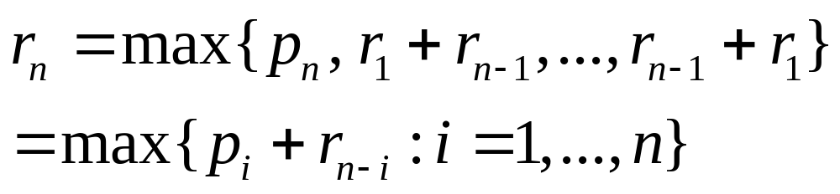
A simpler way

Slide 8
A simpler way to decompose the problem
Every optimal solution has a leftmost cut
  there’s some cut that gives a first piece of length cut off the left end, and a remaining piece of length n - on the right.
Need to divide only the remainder, not the first piece.
Leaves only one subproblem to solve, rather than two subproblems.
Say that the solution with no cuts has first piece size = n with revenue

Slide 9
Recursive top-down solution
CUT-ROD (p, n)
Inefficient, why? Solve subproblems more than once.
  CUT-ROD (p, 2)
  CUT-ROD (p, 1)

Slide 10
Time Complexity

Slide 11
Dynamic-programming solution
Instead of solving the same subproblems repeatedly, arrange to solve each subproblem just once.
Save the solution to a subproblem in a table, and refer back to the table whenever we revisit the subproblem.
“Store, don’t recompute” -> time-memory trade-off.
Can turn an exponential-time solution into a polynomial-time solution.
Two basic approaches:
  top-down with memorization
  bottom-up.

Slide 12
Top-down with memorization
Solve recursively, but store each result in a table.
To find the solution to a subproblem, first look in the table.
  If the answer is there, use it.
  Otherwise, compute and store the solution to the subproblem in the table
Pseudo code– text book

Slide 13
Bottom-up
Sort the subproblems by size and solve the smaller ones first.
When solving a subproblem, have already solved the smaller subproblems we need.
Pseudo code:

Slide 14

Running time
Both the top-down and bottom-up versions run in
Bottom-up: Doubly nested loops. Number of iterations of inner for loop forms an arithmetic series.
Top-down: MEMOIZED-CUT-ROD solves each subproblem just once, and it solves subproblems for sizes 0, 1,…, n.
  To solve a subproblem of size n, the for loop iterates n times
  total number of iterations forms an arithmetic series.

Slide 15
Subproblem graphs
How to understand the subproblems involved and how they depend on each other.
Directed graph:
  One vertex for each distinct subproblem.
  Has a directed edge (x, y) if computing an optimal solution to subproblem x directly requires knowing an optimal solution to subproblem y.
Example:

Slide 16
Reconstructing a solution
So far, have focused on computing the value of an optimal solution, rather than the choices that produced an optimal solution.
Extend the bottom-up approach to record not just optimal values, but optimal choices. Save the optimal choices in a separate table.
Then use a separate procedure to print the optimal choices.

Slide 17
The code and example

Slide 18
Summary: Four steps of dynamic programming
Characterize the structure of an optimal solution.
Recursively define the value of an optimal solution.
Compute the value of an optimal solution in top-down or bottom-up fashion.
Construct an optimal solution from computed information.

Slide 19
2nd example: Optimal binary search trees
Given n sorted distinct keys & associated probabilities
Search problem: find a key from a sorted list.
  Linear search
  Binary search (divide & conquer)

Slide 20
Binary search tree (BST)
A data structure supporting binary search
Each node == a key
All keys in left child: smaller than the current node
All keys in right child: greater than the current node
Search operation: start with root
Time complexity—worst case
Average case with equal probability
Average case with different probabilities (expected search cost)

Slide 21
Different BST results different cost
i | 1 | 2 | 3 | 4 | 5
p | 0.25 | 0.2 | .05 | .2 | .3
How to construct the optimal BST for a given K&P?

Slide 22
Observations
Optimal BST might not have smallest height.
Optimal BST might not have highest-probability key at root.
Build opt BST by exhaustive checking
  How many different BST with n nodes (inner and leaves)?
    Each node: 3 possibilities at least: root, left or right
    Root: n possibilities
    In text book:
  Too expensive

Slide 23
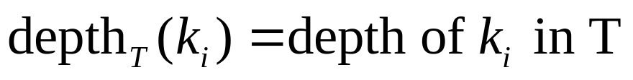
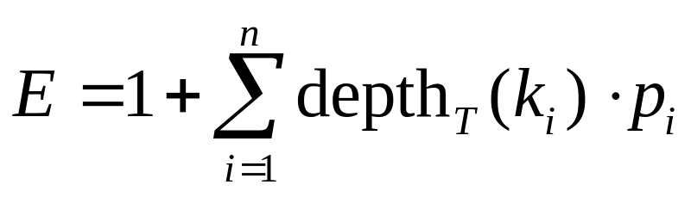
Formulas and notations
Cost of searching cost( )=
E=Average cost = expected search cost of BST T

Slide 24
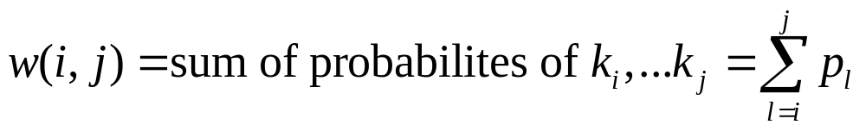
Formulas and notations --continued
Define
Express e[i,j] as function of smaller subtrees

Slide 25
Step 1: Optimal substructure
If T is an optimal BST and T contains subtree T’ with keys
➔T’ must be optimal for those keys
  cut-and-paste proof:
    If T’: not optimal & T” is better than T’
    Cut T’ and paste T”

Slide 26
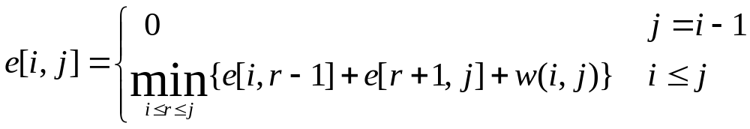
Step 2: Construct a recursion

Slide 27
Step 3: Computing expected search cost of optimal BST
3 tables e[1:n+1, 0:n], w[1:n+1, 0:n], root[1:n+1, 0:n], to store sub problem’s results
  Go by diagonal
  Three nested loops, each one have fewer than n iterations:
  e(i,j): the search cost of the best BST with ki, …, kj
  w(i,j): the total probabilities of ki, …, kj
  root(i,j): the root of the best BST with ki, …, kj
Step 4: construct the optimal BST, see textbook

Slide 28
Example

Slide 29
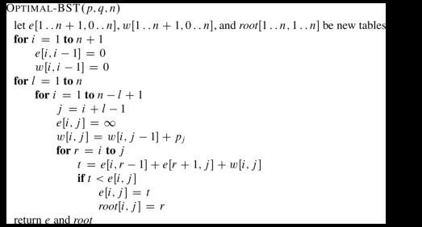
Pseudo Codes

Slide 30
Other examples in book
Matrix chain multiplication
Longest common sequence

Slide 31
Elements of dynamic programming
Optimal substructure
  does not apply to problems without the optimal substructure
Overlapping sub problems
Memoization

Slide 32
Optimal substructure
Show that a solution to a problem consists of making a choice, which leaves one or more subproblems to solve.
Suppose that you are given this last choice that leads to an optimal solution.
Given this choice, determine which subproblems arise and how to characterize the resulting space of subproblems.
Show that the solutions to the subproblems used within the optimal solution must themselves be optimal. Usually use cut-and-paste:
  Suppose that one of the subproblem solutions is not optimal. Cut it out.
  Paste in an optimal solution.
  Get a better solution to the original problem. Contradicts optimality of problem solution.

Slide 33
How to characterize the space of subproblems?
Keep the space as simple as possible.
Expand it as necessary.
Examples: Rod cutting
  Space of subproblems was rods of length n - i , for 1<=i<= n.
  No need to try a more general space of subproblems.

Slide 34
Optimal substructure varies across problem domains
How many subproblems are used in an optimal solution.
How many choices in determining which subproblem(s) to use.
Rod cutting:
  1 subproblem (of size n - i )
  n choices
Optimal binary search tree:
  2 subproblems (ki , . . . , kr−1 and kr+1, . . . , k j )
  j − i + 1 choices for kr in ki, . . . , k j .

Slide 35



Running time=f ( (#subproblems overall) × (# of choices))
Rod cutting: subproblems, <=n choices for each
  running time
Optimal binary search tree: subproblems, O(n) choices for each => running time.

Slide 36
Bottom up approach
Dynamic programming uses optimal substructure bottom up.
  First find optimal solutions to subproblems.
  Then choose which to use in optimal solution to the problem.
Greedy algorithms later, top down:

Slide 37
Optimal substructure does not apply to all optimization problems.
Given an un-weighted, directed graph G = (V, E).
  V is a set of vertices.
  E is a set of edges.
Find a path (sequence of connected edges) from vertex u to vertex v.
Shortest path: find path u -> v with fewest edges, must be simple (no cycles),
Longest simple path: find simple path u -> v with most edges.

Slide 38
Show optimal structure?
Shortest path has optimal substructure.
  proof: see the book
Longest path does not have optimal substructure
  counter example

Slide 39
Summary of dynamic programming
Optimization problems with optimal substructure
4 steps in dynamic programming
2 examples: Rod cutting and BST

